Slide 1


Machine Learning
Data Science Project
banks+financial institutions
customers
loans
Loan Prediction

Slide 2
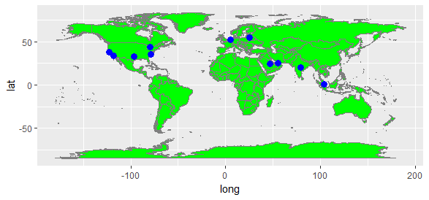
Team Info
Ali Qaiser Syed
Annada Prasad
Chia Aik Lee
Diego Jaramillo
Kiran Devathi
Manoj Kalamkar
Praveen Parvataneni
Subrata Roy
Ravi Bodkai
Vasudev Pendyala

Slide 3
Domain
Banking and Finance
Topic
Loan Prediction
Banks, other financial institutions in the lending business and those who get the loans are at many risks on repayment and credibility. Additionally the growing volumes of these loan transactions, changing customer needs and behaviors, changing rules and procedures of underlying financial institutions demand improved capabilities more than ever for the protection of respective interests and for better business decisions.
This domain and area of this topic is presenting an opportunity to address this problem from the Data Sciences and Analytics perspective. This presentation addresses, how the problem of classifying loans for approvals and declines is handled by modeling Machine Learning Algorithms.
Models are built for the datasets chosen from banking and finance domain to predict the status of loans. Seven machine learning algorithms are modeled in R and results presented. These include Linear Discriminant Analysis, GLM, kNN, Support Vector Machines, CART, Random Forest and Generalized Boosting Model.

Slide 4
Introduction
Project
The project is to determine whether a loan will default by applying ML methods. Also gain and present good insights from financial management perspective.
Objective
Prepare and present the project report on HYFY Google Chrome.
Scope
Dataset – loan.zip contains set of financial transactions associated with the individuals. Has over one thousand observations and each observation is independent from the other.

Slide 5
Dataset Description
Loans data is provided in two distinct datasets in a comma separated format
One each dataset is for training and testing the models
Semi-structured and multi-variate data
Data contains missing values but not missing features
Data seems standardized, de-trended, anonymized and non-time dimensional
It is a classification problem and the goal is to predict if a customer’s request for a loan is approved or declined
Source provided by Upx Academy for data science machine learning project evaluation
sapply(train_loans, class) 614 obs. of 13 variables
Loan_ID | factor
Gender | factor
Married | factor
Dependents | factor
Education | factor
Self_Employed | factor
ApplicantIncome | integer
CoapplicantIncome | integer
LoanAmount | integer
Loan_Amount_Term | integer
Credit_History | integer
Property_Area | factor
Loan_Status | factor
sapply(test_loans, class) 367 obs. of 12 variables
Loan_ID | factor
Gender | factor
Married | factor
Dependents | factor
Education | factor
Self_Employed | factor
ApplicantIncome | integer
CoapplicantIncome | integer
LoanAmount | integer
Loan_Amount_Term | integer
Credit_History | integer
Property_Area | factor

Slide 6
Model Building Steps
Define Problem
Load Required Packages
Data Collection
Preliminary Housekeeping / Data Preparation
Feature Engineering
Perform EDA
Feature Selection
Build Model
Validate Model
Measure Performance
Test Model for Prediction
Present Results

Slide 7
Steps Description
contd..
Datasets given includes customer transactions with a request for loans and contains customers employment, family and income details. Training set has additional information of loan status which test set does not contain. The goal is to build a predictive analysis model using the training set and be able to classify each of the loan requests as either loan approved or loan declined. Based on this classification model, predict the test set loans requests.
Its assumed that this model will work unique to the nature of this dataset and is not a generic model to apply on all instances.
Define Problem
Get ready to work ahead on the problem. Install and load required packages to help advance with the model building. Primarily packages contain pre-built, compiled code and includes algorithms, functions and data in well defined format. These are stored in library. Thus install packages and load libraries.
Load Packages

Slide 8
Steps Description
contd..
Read in data from the given datasets with appropriate methods ensuring no data loss. Data provided was included in comma separated formatted files. Apply the standard function read.csv to collect the data into separate data frames to work with ahead.
Data Collection
Perform general housekeeping activities such as checking for the completeness of the content, look at the dimensions, review the structure, peek into the data, summarize the data, and get a snapshot of all the features. This is also to make a note that the data actually provided has relevance to the problem intended to address for.
Further clean up and format the data properly to deep dive further with it. Investigate for missing data and values, decide on an action to deal with it and perform the actions. As a final step, transform the data into a format ready to apply with the algorithms and modelling.
Data Preparation

Slide 9
Steps Description
contd..
In simple terms, this is to engineer features from given datasets for the problem addressing for. Investigate for features influencing predictive models, review for better features (features that have relevance to the underlying problem), and consider to use them with it algorithms. Discover to derive new features that influence predictive power from the domain principles. This will enhance and improve the outcomes. In this case its noticed that applicant’s combined income may be a good feature to consider.
Feature Engineering
Along the lines with the feature selection, perform EDA (exploratory data analysis) to understand the data and its applicability on the problem. Understand how the data and the features variate, are interrelated, correlated, presence of outliers and its effects, summarize the data with box plots, plots of histograms, scatter plots and more.
A better EDA leads to better understanding for the algorithm selection, preprocess if any is required and selecting parameters for model building. Also helps in generalizing the results on the usage of features and extent of influence.
Perform EDA

Slide 10
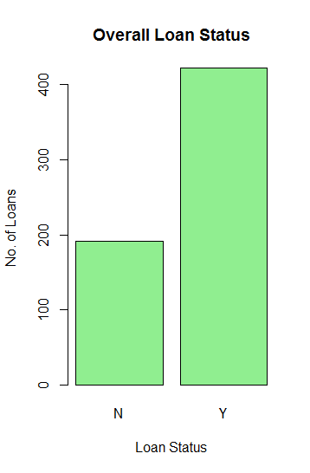
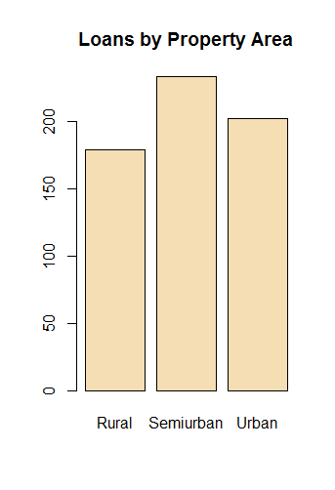
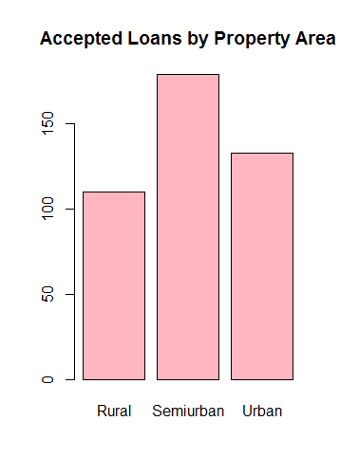
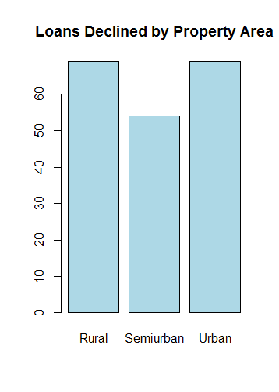
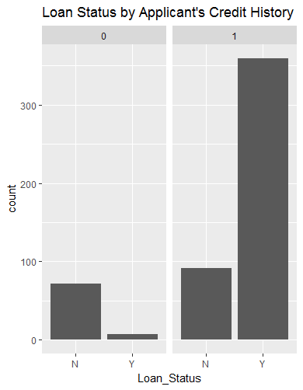
Steps Description
contd..
Exploratory Analysis Graphs

Slide 11
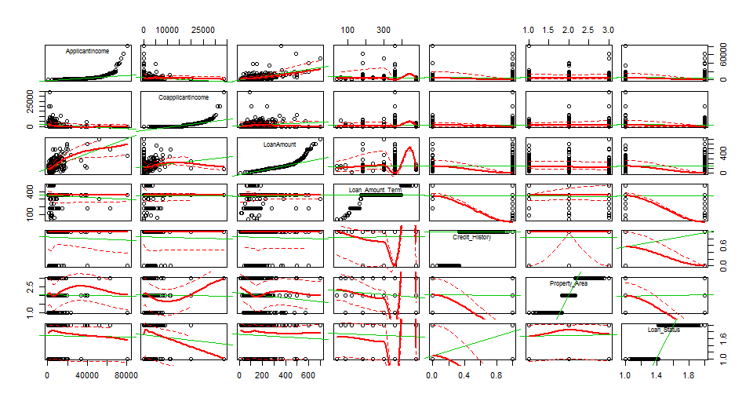
Steps Description
contd..
Multivariate Analysis – Scatter Plot

Slide 12
Steps Description
contd..
From feature engineering and EDA, its now possible to arrive at better decisions that enable us to select the applicable features. Drop the features that may not influence predictive power and prepare a selection set to use with algorithms. Also include derived features that are assumed to improve the model outcome.
Feature Selection
Pick a set of models that are relevant to the problem. In this case it is a binary classification problem (Linear Method – LDA, Ensemble Method – Random Forest etc are selected). Set a random seed to set consistency with the application run time. Split the given dataset (not the test dataset) to train the algorithmic model and to validate the model build. Decide on a ratio for this split. In this case a 80:20::Train : Test ratio is considered. Consider train control parameters with resampling and type of cross validation. Consider preprocessing parameters for the applicable algorithms. Consider other parameters applicable to the respective algorithms Ex: k-fold cross validation etc. With this selection, apply and build models on train dataset for predictive feature.
Build Model

Slide 13
Steps Description
contd..
set.seed(999)
fit.lda <- train(Loan_Status~., data=train_dp_loans, method="lda", preProcess=c("center", "scale"), maximize = TRUE, trControl=tC)
set.seed(999)
fit.glm <- train(Loan_Status~., data=train_dp_loans, method="glm", preProcess=c("center", "scale"), maximize = TRUE, trControl=tC)
set.seed(999)
fit.knn <- train(Loan_Status~., data=train_dp_loans, method="knn", preProcess=c("center", "scale"), maximize = TRUE, trControl=tC)
set.seed(999)
fit.svm <- train(Loan_Status~., data=train_dp_loans, method="svmRadial", preProcess=c("center", "scale"), maximize = TRUE, trControl=tC)
set.seed(999)
fit.cart <- train(Loan_Status~., data=train_dp_loans, method="rpart", metric="Accuracy", trControl=tC)
set.seed(999)
fit.rf <- train(Loan_Status~., data=train_dp_loans, method="rf", metric="Accuracy", trControl=tC)
set.seed(999)
fit.gbm <- train(Loan_Status~., data=train_dp_loans, method="gbm", metric="Accuracy", trControl=tC, verbose=FALSE)
Build Model

Slide 14
Steps Description
contd..
Validate the various models those were built for effectiveness and accuracy metrics against the validation dataset. Review model’s resultant parameters, coefficients, plot various graphs to understand the outcome.
Validate Model
Confusion Matrix is used to describe the performance of the classification models.
Lift Curve shows the evaluation of probability threshold against percentage of hits.
Calibration curve shows how well a classifier is calibrated. It’s a parametric graph showing true probabilities against predicted probability.
ROC Curve shows performance of the classification model, by plotting TPR - Sensitivity (true positive rate), FPR -1-Specificity (false positive rate) at various threshold settings.
Measure Performance

Slide 15
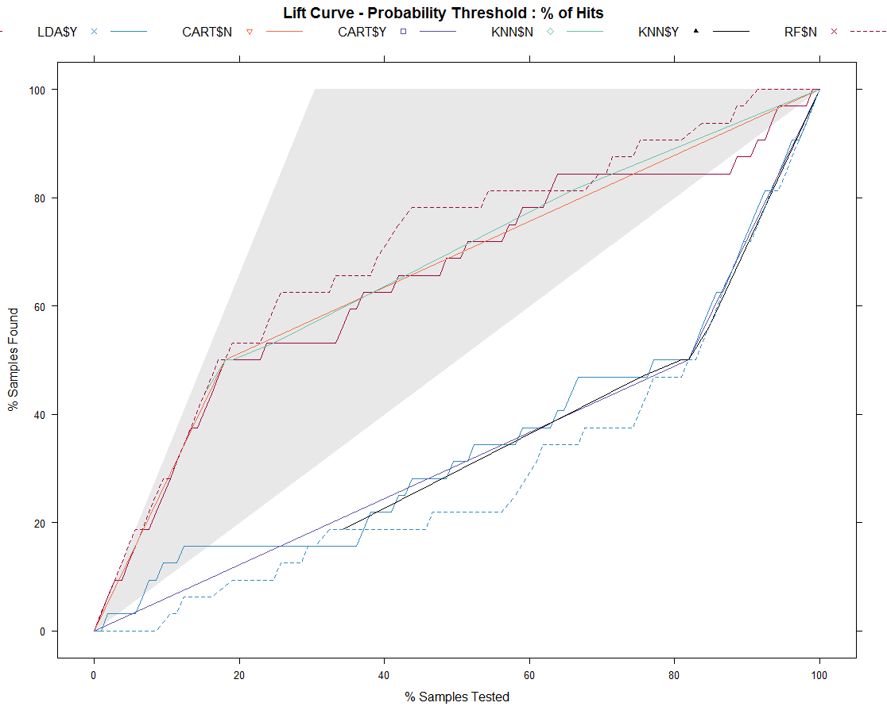
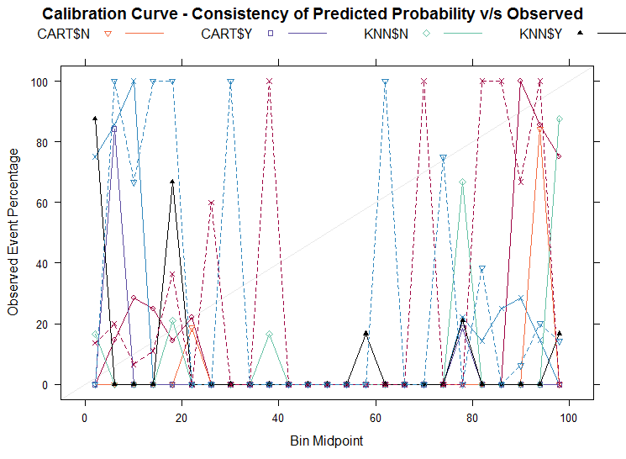
Steps Description
contd..
Performance Graphs

Slide 16
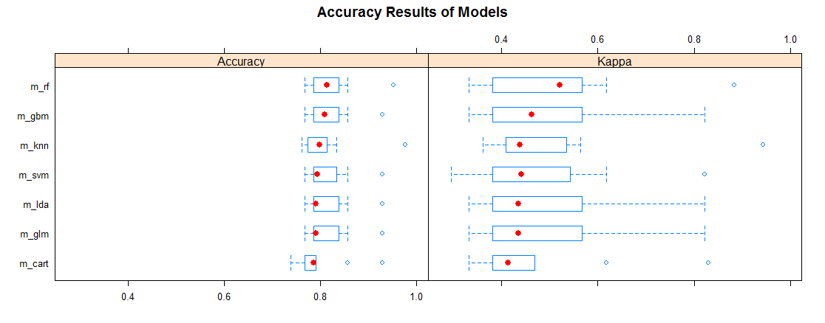
Steps Description
contd..
Apply the best models from the selection and institutionalize to address the problem with test or real datasets. In this case, the models are applied to predict for Loan Defaults on the Test Dataset that was provided. Models are measured for Accuracy and Kappa Metrics.
Test Model
Present Results

Slide 17
Conclusion
Ensemble Random Forest is chosen as best model.
This has improved accuracy due to derived new feature.
With Original Features
Data | Method | Model | Metric
 |  |  | Accuracy | Kappa
Validation Data | Linear | Linear Discriminant Analysis | 0.819 | 0.518
Validation Data | Non-Linear / Ensemble | SVM / Random Forest | 0.819 | 0.518
With New Feature Added per Banking Principle – Combined Income
Validation Data | Ensemble | Random Forest | 0.8762 | 0.6828
Validation Data | Ensemble | GBM | 0.8381 | 0.5771

Slide 18
Conclusion
Predictions and ROC Curve
Relative Comparison of Original Dataset vs Derived Dataset
Prediction N Y
N 16 3
Y 16 70
Slot-"x.values": 0.0000 0.5000 1.0000
Slot-"y.values": 0.0000 0.9589 1.0000
Accuracy : 0.819
Prediction N Y
N 21 2
Y 11 71
Slot-"x.values": 0.0000 0.3437 1.0000
Slot-"y.values": 0.0000 0.9726 1.0000
Accuracy : 0.8762

Slide 19

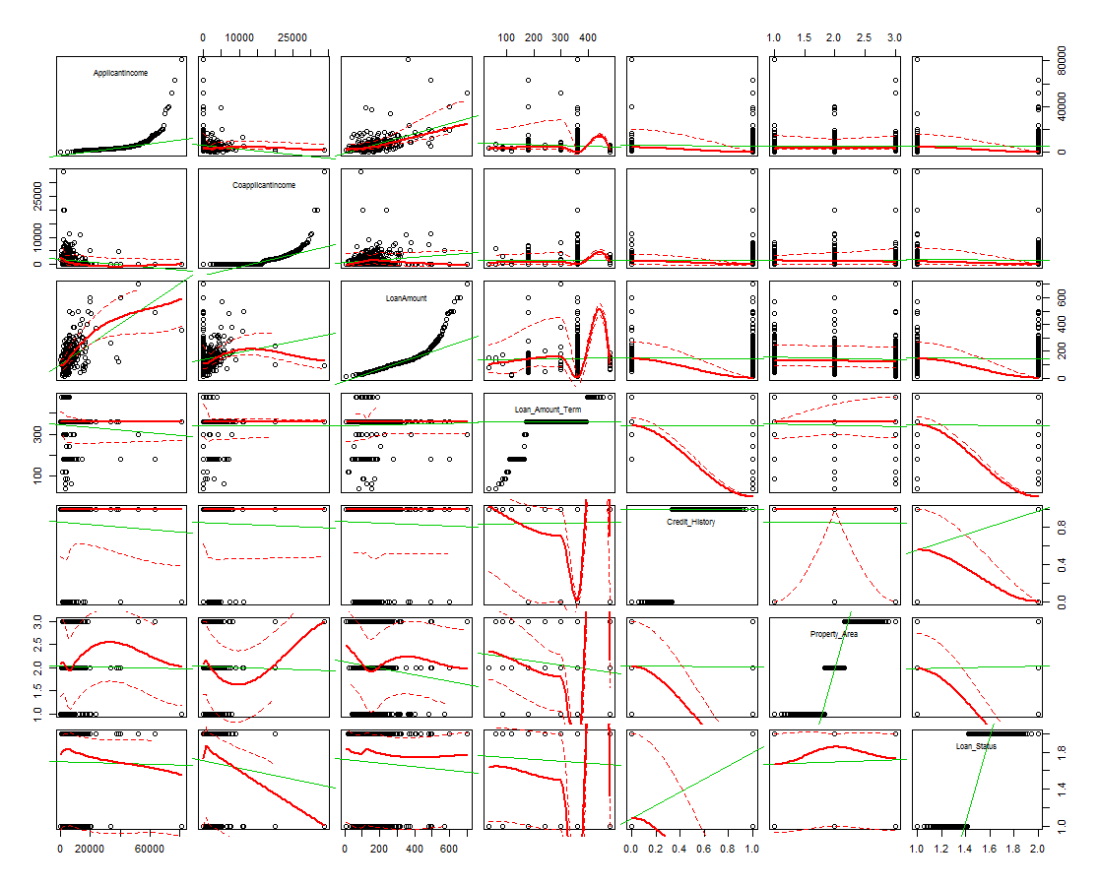

Data is the new oil & Analytics is the new combustion engine
Thank You

